Slide 1
ENEL 419 PROBABILITY AND RANDOM VARIABLES
CONDITIONAL PROBABILITY AND INDEPENDENCE
(Reading Exercises: Montgomery and Runger Chapter 2 - Sections 2.5-2.8)

Slide 2
Concept of Conditional Probability
Definition: A conditional event is one whose occurrence depends on prior occurrence of another event.
Examples:
Suppose we roll a die twice in succession and the sum of the two rolls is 9. What is the probability that the ﬁrst roll is a 6?
Suppose in a word guessing game the ﬁrst letter is a “t”. What is the probability that the second letter is an “h”?
Suppose a medical test was negative. What is the probability that a person has a disease given that the test is negative?
Suppose a spot shows up on a radar screen. What is the probability that the spot corresponds to an aircraft?

Slide 3
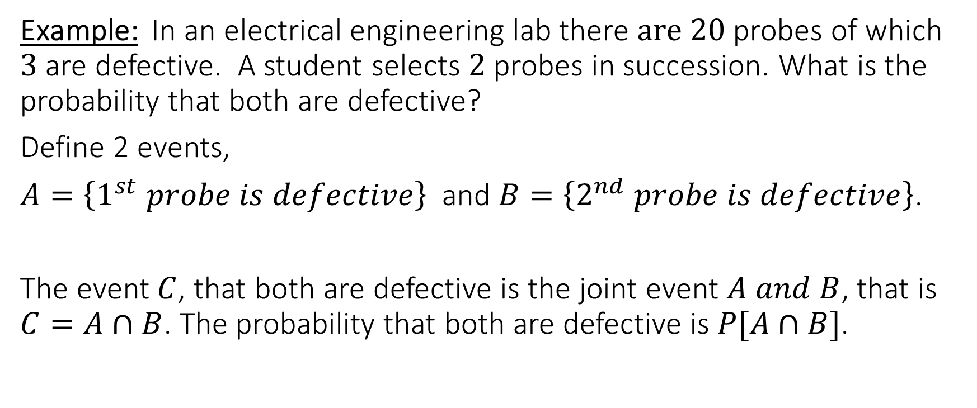
Definition of Conditional Probability
Example: In an electrical engineering lab there $are 20$ probes of which $3$ are defective. A student selects $2$ probes in succession. What is the probability that both are defective?
Define 2 events,
$A=\left\{1^{st} probe is defective\right\}$ and $B=\left\{2^{nd} probe is defective\right\}$.
The event $C$, that both are defective is the joint event $A and B$, that is $C=A∩B$. The probability that both are defective is $P[A∩B]$.

Slide 4
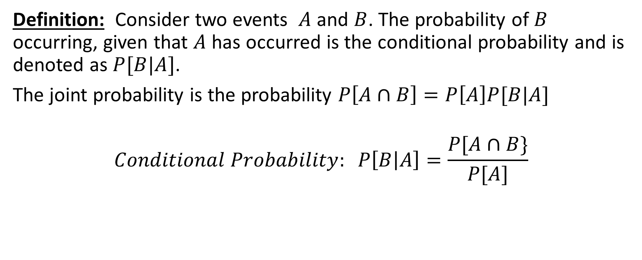
Definition of Conditional Probability
Definition: Consider two events $A$ and $B$. The probability of $B$ occurring, given that $A$ has occurred is the conditional probability and is denoted as $P[B|A]$.
The joint probability is the probability $P\left[A∩B\right]=P\left[A\right]P[B|A]$
$$Conditional Probability: P\left[B | A\right]=\frac{P[A∩B\}}{P[A]}$$

Slide 5
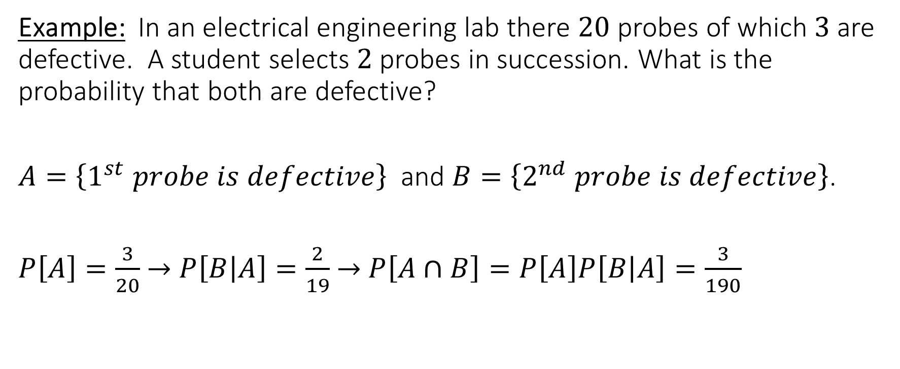
Conditional Probability Example
Example: In an electrical engineering lab there $20$ probes of which $3$ are defective. A student selects $2$ probes in succession. What is the probability that both are defective?
$A=\left\{1^{st} probe is defective\right\}$ and $B=\left\{2^{nd} probe is defective\right\}$.
$P\left[A\right]=\frac{3}{20}$ $→$ $P\left[B | A\right]=\frac{2}{19}$ $→$ $P\left[A∩B\right]=P\left[A\right]P\left[B | A\right]=\frac{3}{190}$

Slide 6
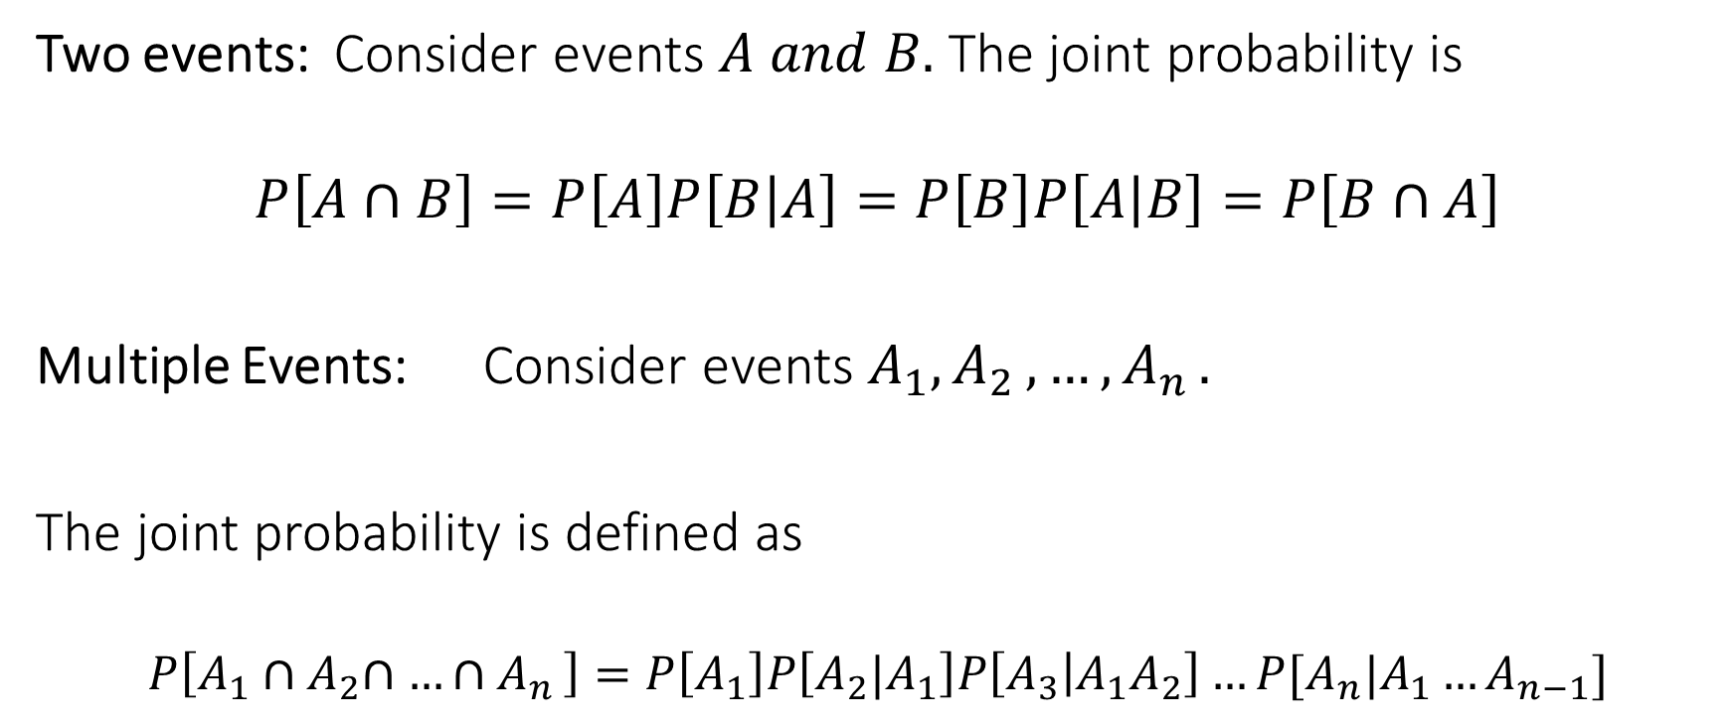
Joint Probability for Multiple Conditional Events
Two events: Consider events $A and B.$ The joint probability is
$$P\left[A∩B\right]=P\left[A\right]P\left[B | A\right]=P\left[B\right]P\left[A | B\right]=P\left[B∩A\right]$$
Multiple Events: Consider events $A_{1}{, A}_{2}{, …,A}_{n}.$
The joint probability is defined as
$$P\left[A_{1}{∩A}_{2}∩{…∩A}_{n}\right]=P\left[A_{1}\right]P\left[A_{2}|A_{1}\right]P\left[A_{3} | A_{1}A_{2}\right]…P[A_{n}|A_{1}…A_{n−1}]$$

Slide 7
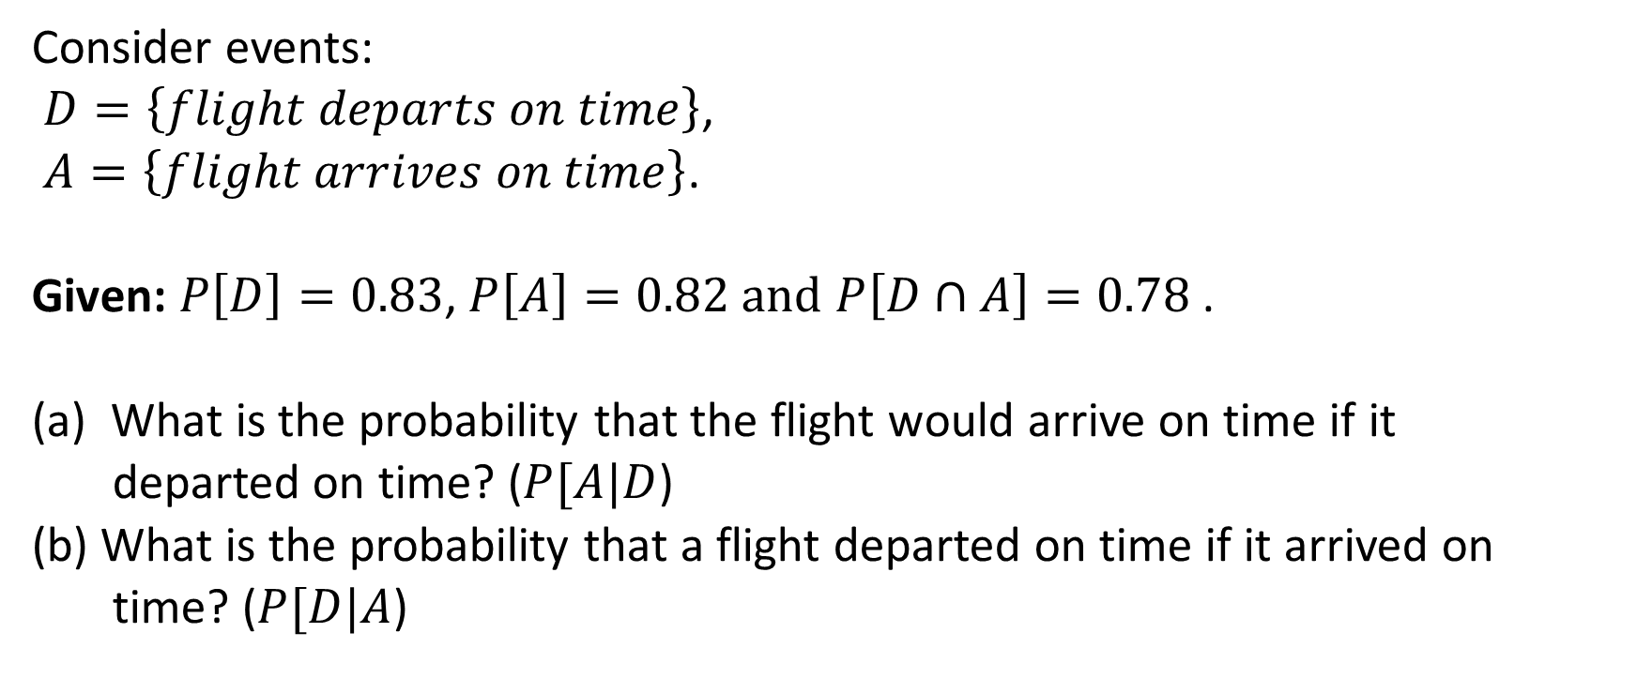
Conditional Probability – Example 1
Consider events:
$D=\left\{flight departs on time\right\}$,
$A=\left\{flight arrives on time\right\}$.
Given: $P\left[D\right]=0.83$, $P\left[A\right]=0.82 and$ $P\left[D∩A\right]=0.78$ .
What is the probability that the flight would arrive on time if it
departed on time? ($P[A|D$)
(b) What is the probability that a flight departed on time if it arrived on
time? ($P[D|A$)

Slide 8
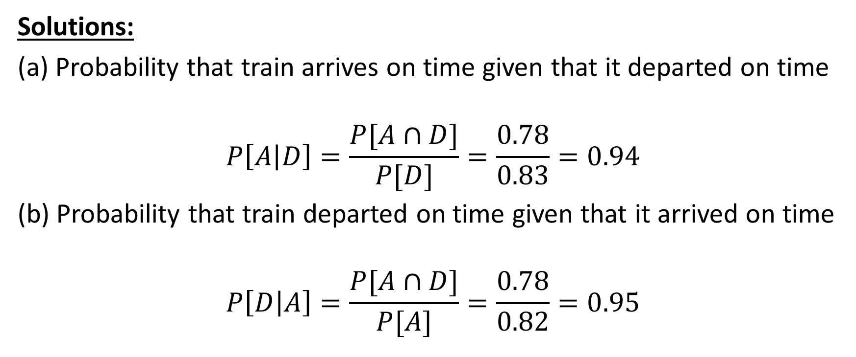
Conditional Probability – Example 1
Solutions:
(a) Probability that train arrives on time given that it departed on time
$$P\left[A | D\right]=\frac{P[A∩D]}{P[D]}=\frac{0.78}{0.83}=0.94$$
(b) Probability that train departed on time given that it arrived on time
$$P\left[D | A\right]=\frac{P[A∩D]}{P[A]}=\frac{0.78}{0.82}=0.95$$

Slide 9
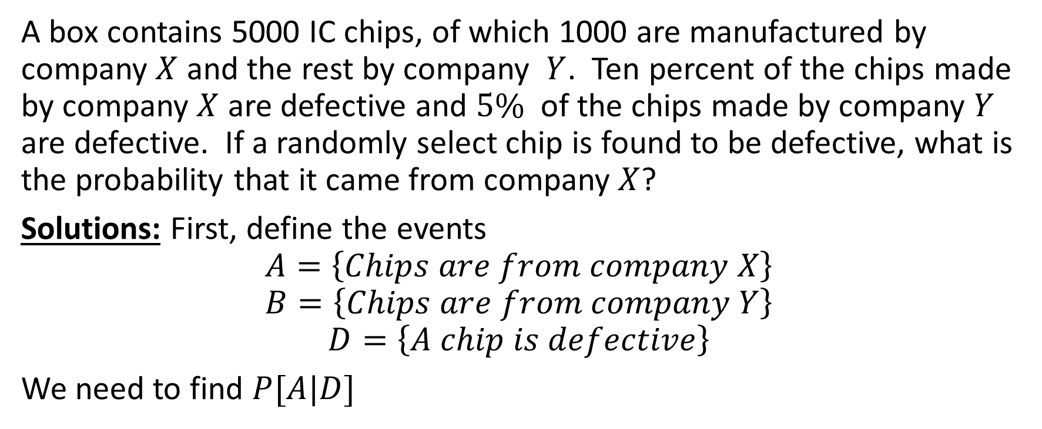
Conditional Probability – Example 2
A box contains 5000 IC chips, of which 1000 are manufactured by company $X$ and the rest by company $Y$. Ten percent of the chips made by company $X$ are defective and $5\%$ of the chips made by company $Y$ are defective. If a randomly select chip is found to be defective, what is the probability that it came from company $X$?
Solutions: First, define the events
$$A=\left\{Chips are from company X\right\}$$
$$B=\left\{Chips are from company Y\right\}$$
$$D=\left\{A chip is defective\right\}$$
We need to find $P[A|D]$

Slide 10
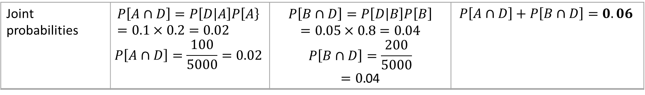
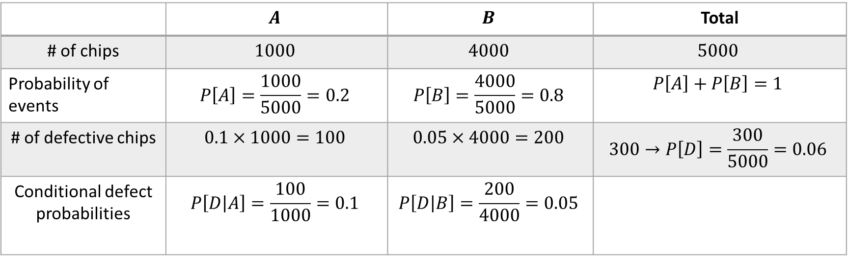
Conditional Probability – Example 2
For convenience, we can create the following table:
 | $$A$$ | $$B$$ | Total
# of chips | $$1000$$ | $$4000$$ | $$5000$$
Probability of events | $$P\left[A\right]=\frac{1000}{5000}=0.2$$ | $$P\left[B\right]=\frac{4000}{5000}=0.8$$ | $$P\left[A\right]+P\left[B\right]=1$$
# of defective chips | $$0.1×1000=100$$ | $$0.05×4000=200$$ | $$300→P\left[D\right]=\frac{300}{5000}=0.06$$
Conditional defect probabilities | $$P\left[D | A\right]=\frac{100}{1000}=0.1$$ | $$P\left[D | B\right]=\frac{200}{4000}=0.05$$
Joint probabilities | $$P\left[A∩D\right]=P\left[D | A\right]P\left[A\right\}=0.1×0.2=0.02$$ $$P\left[A∩D\right]=\frac{100}{5000}=0.02$$ | $$P\left[B∩D\right]=P\left[D | B\right]P\left[B\right]$$ $$=0.05×0.8=0.04$$ $$P\left[B∩D\right]=\frac{200}{5000}$$ $=0.$04 | $$P\left[A∩D\right]+P\left[B∩D\right]=0.06$$

Slide 11
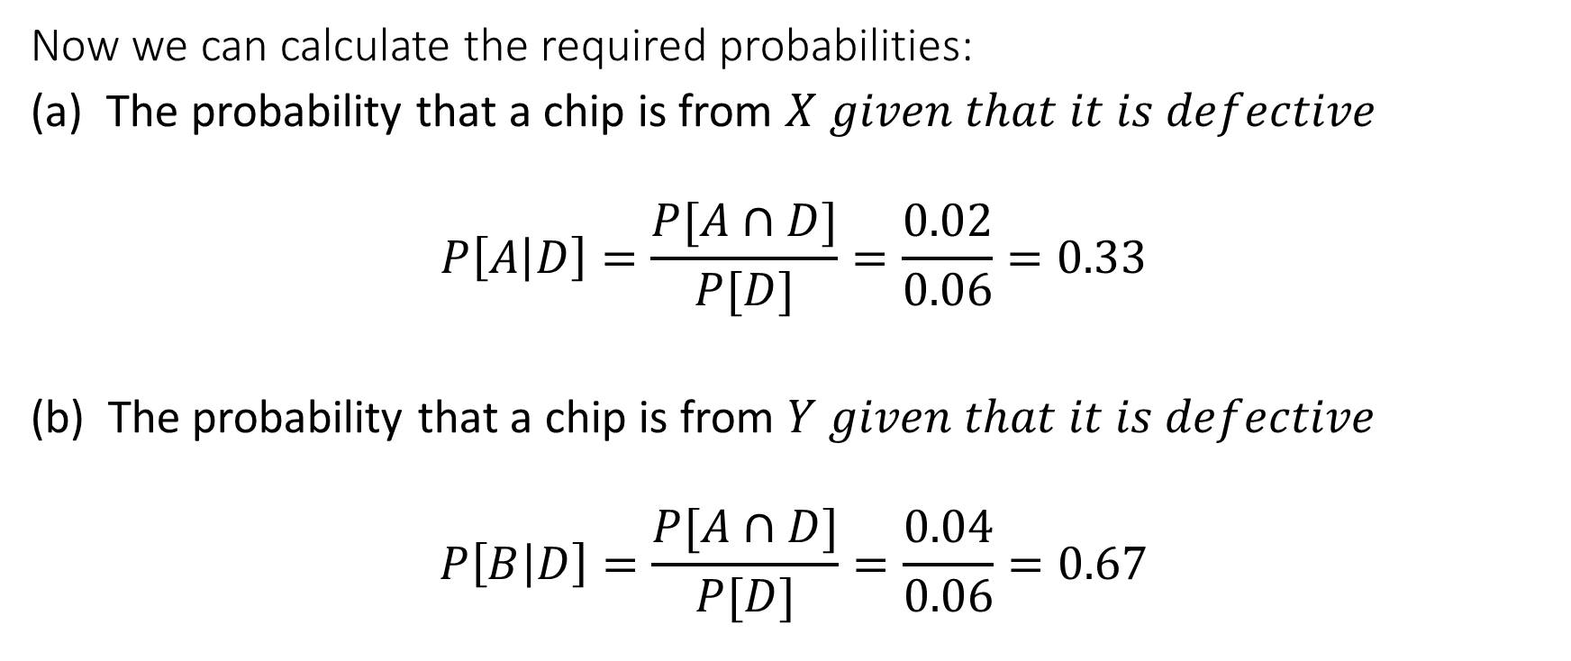
Conditional Probability – Example 2
Now we can calculate the required probabilities:
The probability that a chip is from $X given that it is defective$
$$P\left[A | D\right]=\frac{P[A∩D]}{P[D]}=\frac{0.02}{0.06}=0.33$$
(b) The probability that a chip is from $Y given that it is defective$
$$P\left[B | D\right]=\frac{P[A∩D]}{P[D]}=\frac{0.04}{0.06}=0.67$$

Slide 12
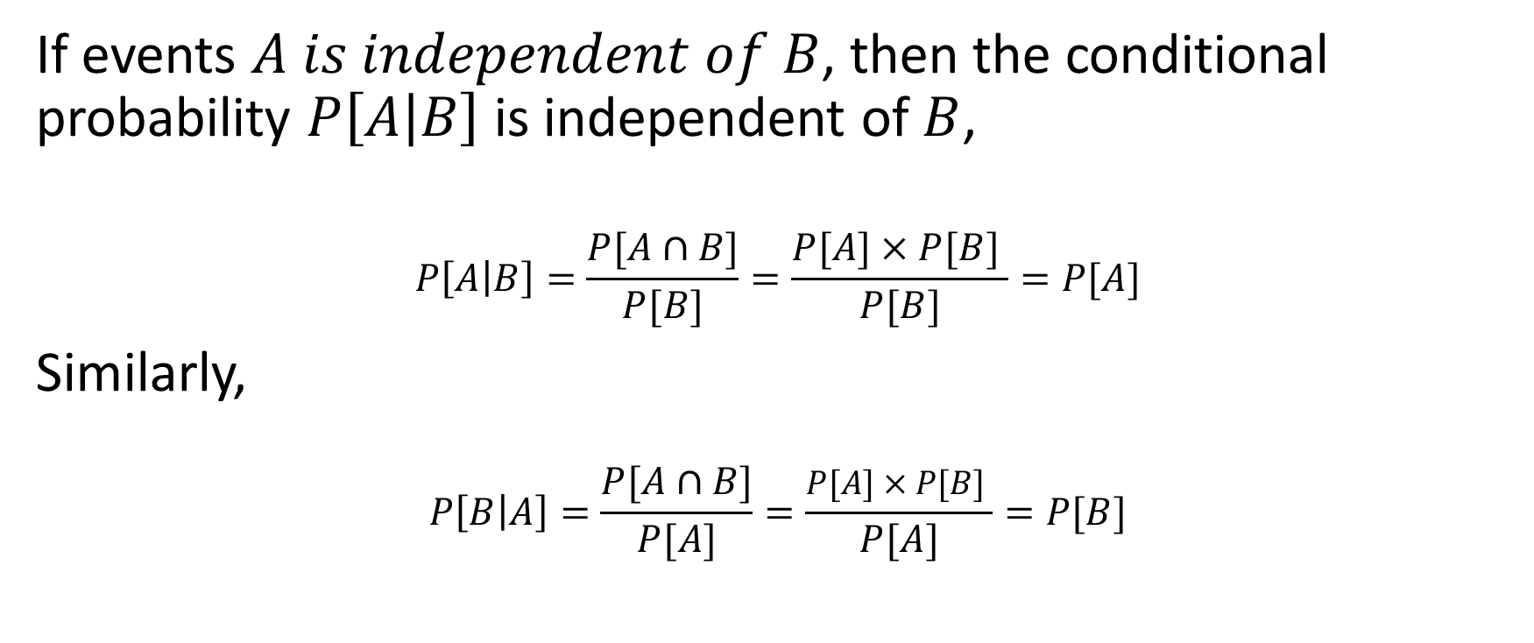
Independence of Events
If events $A is independent of B$, then the conditional probability $P\left[A | B\right]$ is independent of $B$,
$$P\left[A | B\right]=\frac{P[A∩B]}{P[B]}=\frac{P[A]×P[B] }{P[B]}=P[A]$$
Similarly,
$$P\left[B | A\right]=\frac{P[A∩B]}{P[A]}=\frac{P[A]×P[B] }{P[A]}=P[B]$$

Slide 13
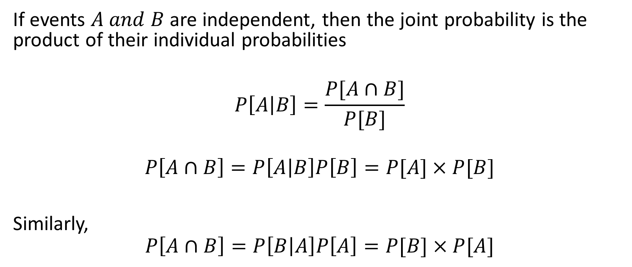
Independence of Events
If events $A and B$ are independent, then the joint probability is the product of their individual probabilities
$$P\left[A | B\right]=\frac{P[A∩B]}{P[B]}$$
$$P\left[A∩B\right]=P\left[A | B\right]P\left[B\right]=P[A]×P[B]$$
Similarly,
$$P\left[A∩B\right]=P\left[B | A\right]P\left[A\right]=P[B]×P[A]$$

Slide 14
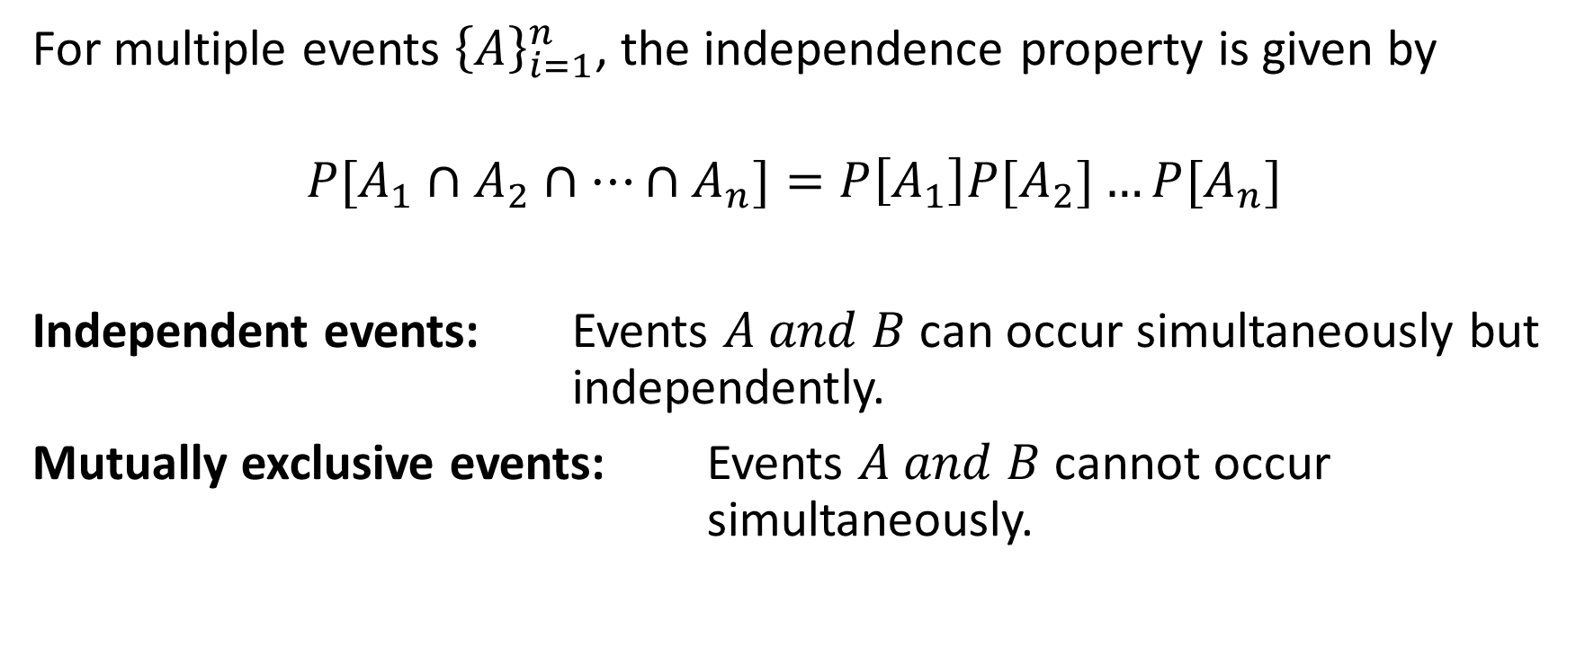
Independence of Multiple Events
For multiple events ${\left\{A\right\}}_{i=1}^{n}$, the independence property is given by
$$P[A_{1}∩A_{2}∩…∩A_{n}]=P\left[A_{1}\right]P{[A}_{2}]…P[A_{n}]$$
Independent events: Events $A and B$ can occur simultaneously but independently.
Mutually exclusive events: Events $A and B$ cannot occur simultaneously.

Slide 15
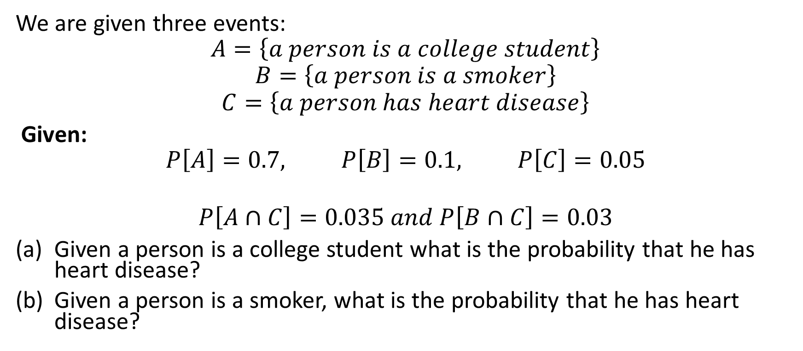
Independence of Events – Example 1
We are given three events:
$$A=\left\{a person is a college student\right\}$$
$$B=\left\{a person is a smoker\right\}$$
$$C=\left\{a person has heart disease\right\}$$
Given:
$$P\left[A\right]=0.7, P\left[B\right]=0.1, P\left[C\right]=0.05$$
$$P\left[A∩C\right]=0.035 and P\left[B∩C\right]=0.03$$
Given a person is a college student what is the probability that he has heart disease?
Given a person is a smoker, what is the probability that he has heart disease?

Slide 16
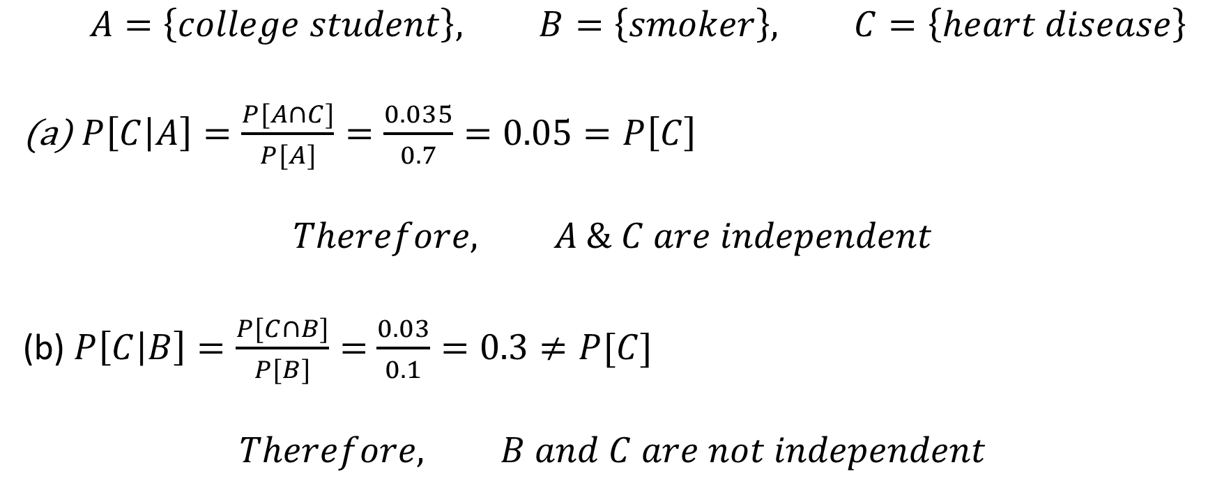
Independence of Events – Example 1 Solutions
$$A=\left\{college student\right\}, B=\left\{smoker\right\}, C=\left\{heart disease\right\}$$
$P\left[C | A\right]=\frac{P[A∩C]}{P[A]}=\frac{0.035}{0.7}=0.05=P\left[C\right]$
$$Therefore, A \& C are independent$$
(b) $P\left[C | B\right]=\frac{P[C∩B]}{P[B]}=$ $\frac{0.03}{0.1}=0.3≠P[C]$
$$Therefore, B and C are not independent$$

Slide 17

The Theorem of Total Probability
Given (disjoint) subevents ${\left\{B_{i}\right\}}_{i=1}^{n}$, contribute to event $A$. We want to find the probability of $A in terms$subevents ${\left\{B_{i}\right\}}_{i=1}^{n}.$
$S=\sum_{i=1}^{n}{B_{i}}$.

Slide 18
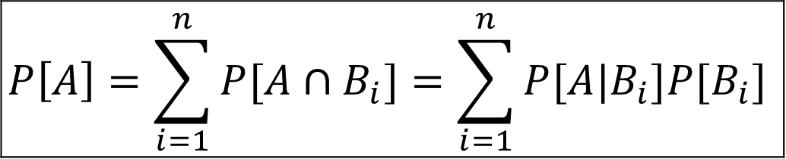
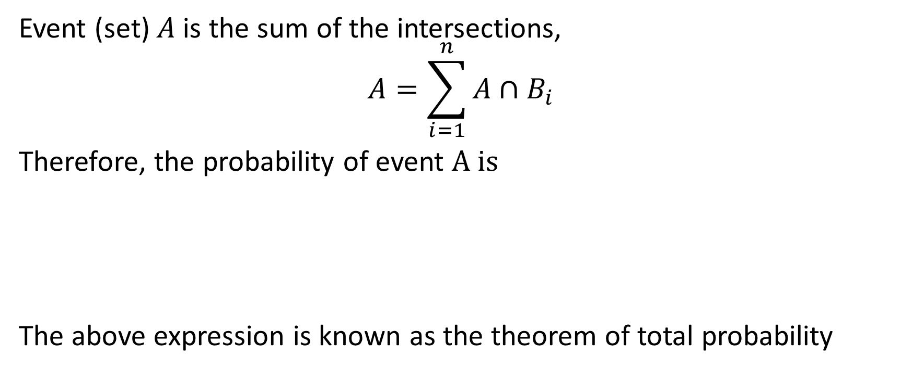
The Theorem of Total Probability
Event (set) $A$is the sum of the intersections,
$$A=\sum_{i=1}^{n}{A∩B_{i}}$$
Therefore, the probability of event $A is$
The above expression is known as the theorem of total probability
$$P\left[A\right]=\sum_{i=1}^{n}{P[A∩B_{i}]}=\sum_{i=1}^{n}{P[A|B_{i}]P[B_{i}]}$$

Slide 19
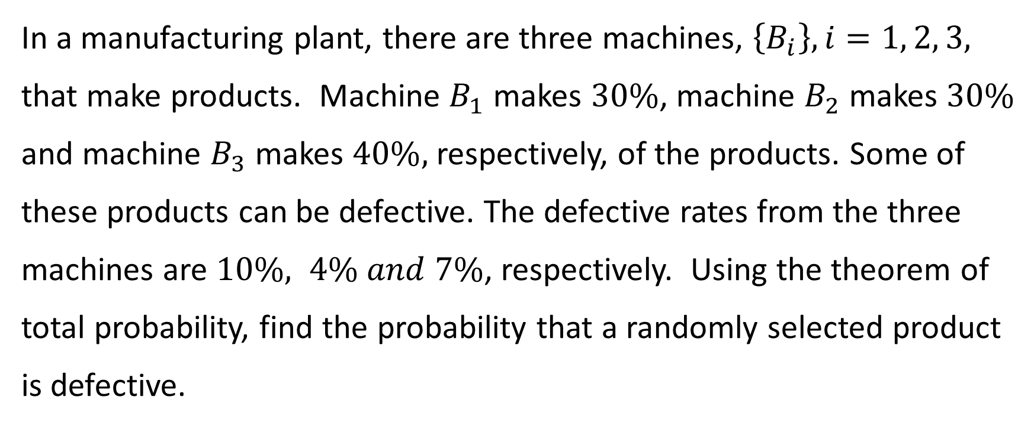
Theorem of Total Probability – Example 1
In a manufacturing plant, there are three machines, $\left\{B_{i}\right\}, i=1, 2, 3,$ that make products. Machine $B_{1}$ makes $30\%$, machine $B_{2}$ makes $30\%$ and machine $B_{3}$ makes $40\%,$ respectively, of the products. Some of these products can be defective. The defective rates from the three machines are $10\%, 4\% and 7\%$, respectively. Using the theorem of total probability, find the probability that a randomly selected product is defective.

Slide 20
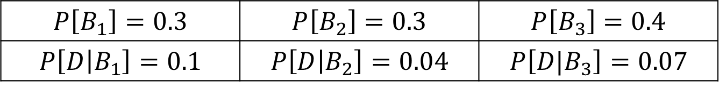
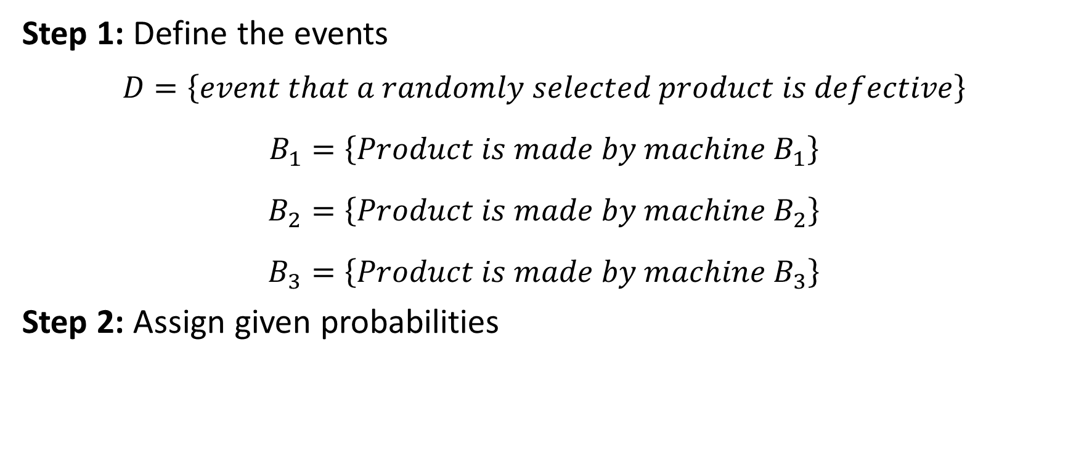
Theorem of Total Probability – Example 1 Solutions
Step 1: Define the events
$$D=\left\{event that a randomly selected product is defective\right\}$$
$$B_{1}=\left\{Product is made by machine B_{1}\right\}$$
$$B_{2}=\left\{Product is made by machine B_{2}\right\}$$
$$B_{3}=\left\{Product is made by machine B_{3}\right\}$$
Step 2: Assign given probabilities
$$P\left[B_{1}\right]=0.3$$ | $$P\left[B_{2}\right]=0.3$$ | $$P\left[B_{3}\right]=0.4$$
$$P\left[D | B_{1}\right]=0.1$$ | $$P\left[D | B_{2}\right]=0.04$$ | $$P\left[{D|B}_{3}\right]=0.07$$

Slide 21
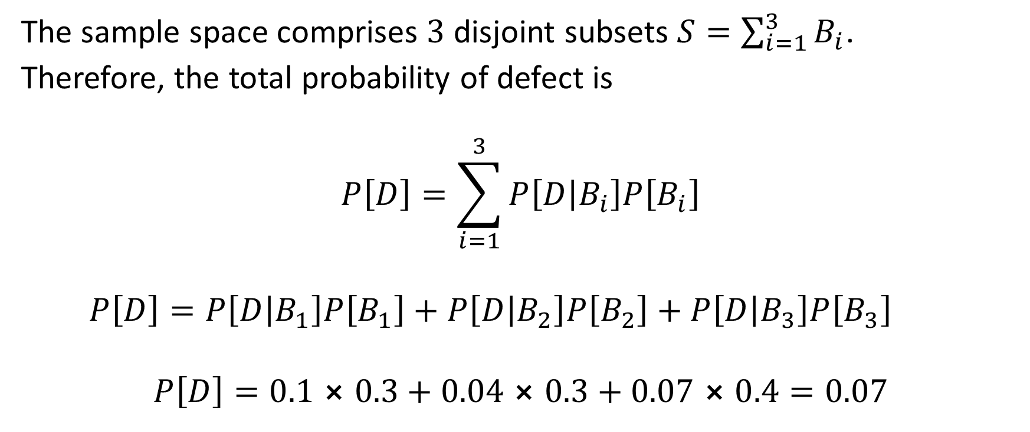
Theorem of Total Probability – Example 1 continued
The sample space comprises $3$ disjoint subsets $S=\sum_{i=1}^{3}{B_{i}}$.
Therefore, the total probability of defect is
$$P\left[D\right]=\sum_{i=1}^{3}{P\left[D | B_{i}\right]P\left[B_{i}\right]}$$
$$P\left[D\right]=P\left[D | B_{1}\right]P\left[B_{1}\right]+P\left[D | B_{2}\right]P\left[B_{2}\right]+P\left[D | B_{3}\right]P\left[B_{3}\right]$$
$$P\left[D\right]=0.1⨯0.3+0.04⨯0.3+0.07⨯0.4=0.07$$

Slide 22
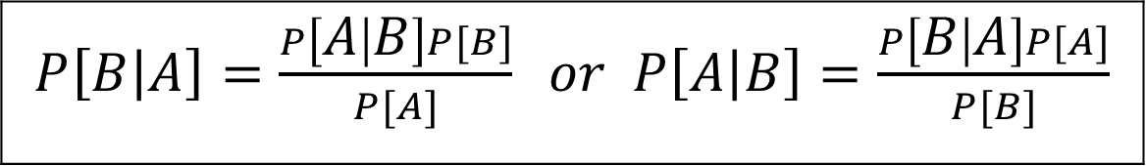
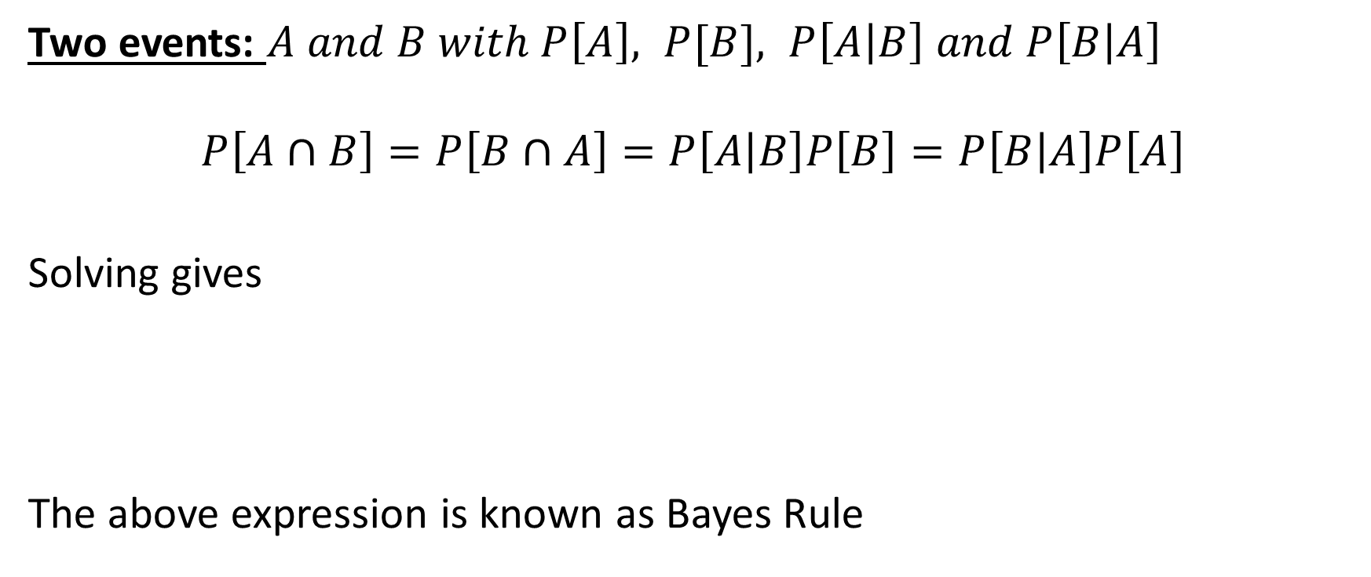
Bayes Rule
Two events: $A and B with P\left[A\right], P[B], P\left[A | B\right] and P\left[B | A\right]$
$$P\left[A∩B\right]=P\left[B∩A\right]=P\left[A | B\right]P\left[B\right]=P\left[B | A\right]P\left[A\right]$$
Solving gives
The above expression is known as Bayes Rule
$P\left[B | A\right]=\frac{P\left[A | B\right]P[B]}{P[A]} or$ $P\left[A | B\right]=\frac{P\left[B | A\right]P[A]}{P[B]}$

Slide 23
Example Application to Criminal Justice https://www.theguardian.com/law/2011/oct/02/formula-justice-bayes-theorem-miscarriage

Slide 24
Generalized Bayes Rule
Suppose the sample space is partitioned into $n$ disjoint events ${\left\{B_{i}\right\}}_{i=1}^{n}.$ Then $P\left[A\right]=\sum_{i=1}^{n}{P\left[A | B_{i}\right]P[B_{i}]}$
The above expression is known as the generalized Bayes Rule
$$P\left[B_{i} | A\right]=\frac{P\left[A | B_{i}\right]P[B_{i}]}{P[A]}=\frac{P\left[A | B_{i}\right]P[B_{i}]}{\sum_{i}^{n}{P\left[A | B_{i}\right]P[B_{i}]}}, i=1,2,…,n$$

Slide 25
Generalized Bayes Rule - Definitions
A priori probability $P\left[B_{i}\right]:$ Probability of event $B_{i}$ (no condition given)
A posteriori probability $P\left[B_{i} | A\right]:$ Probability of event$B_{i}$ given
condition (or evidence) that $A$ is true.
Likelihood probability $P\left[{A|B}_{i}\right]:$ Probability of the condition $A$ given
event $B_{i}$ is true
A Priori probability $P\left[A\right]−$ Probability of the condition (or evidence)

Slide 26
Bayes Rule – Example 1
In a manufacturing plant, there are three machines, $\left\{B_{i}\right\}, i=1, 2, 3,$ that make products. Machine $B_{1}$ makes $30\%$, machine $B_{2}$ makes $30\%$ and machine $B_{3}$ makes $40\%,$ respectively, of the products. Some of these products can be defective. The defective rates from the three machines are $10\%, 4\% and 7\%$, respectively. Find the probability that if a randomly selected product is defective (1) it is coming from $B_{1}$, (2) it is coming from $B_{2}$ and (3) it is coming from $B_{3}$.

Slide 27
Theorem of Total Probability – Example 1 Solutions
Step 1: Define the events
$$D=\left\{event that a randomly selected product is defective\right\}$$
$$B_{1}=\left\{Product is made by machine B_{1}\right\}$$
$$B_{2}=\left\{Product is made by machine B_{2}\right\}$$
$$B_{3}=\left\{Product is made by machine B_{3}\right\}$$
Step 2: Assign given probabilities
$$P\left[B_{1}\right]=0.3$$ | $$P\left[B_{2}\right]=0.3$$ | $$P\left[B_{3}\right]=0.4$$
$$P\left[D | B_{1}\right]=0.1$$ | $$P\left[D | B_{2}\right]=0.04$$ | $$P\left[{D|B}_{3}\right]=0.07$$

Slide 28
Bayes’ Rule – Example 1 Solutions continued
We need to find
$$P\left[B_{i} | D\right]=P[product is from B_{i} given that it is defective]$$
we need to use the generalized Bayes rule.
$$P\left[B_{i} | D\right]=\frac{P\left[D | B_{i}\right]P[B_{i}]}{P[D]}=\frac{P\left[D | B_{i}\right]P[B_{i}]}{\sum_{i}^{n}{P\left[D | B_{i}\right]P[B_{i}]}}$$
$$P\left[D\right]=P\left[D | B_{1}\right]P\left[B_{1}\right]+P\left[D | B_{2}\right]P\left[B_{2}\right]P\left[D | B_{3}\right]P\left[B_{3}\right]$$
$=0.1⨯0.3+0.04⨯0.3+0.07⨯0.4=0.07$

Slide 29
Bayes Rule – Example 1 Solutions continued
$$P\left[B_{1}|D\right]=\frac{P\left[D | B_{1}\right]P[B_{1}]}{P[D]}=\frac{0.1×0.3}{0.07}=0.43$$
$$P\left[B_{2}|D\right]=\frac{P[D|B_{2}]P[B_{2}]}{P[D]}=\frac{0.04×0.3}{0.07}=0.17$$
$$P\left[B_{3}|D\right]=\frac{P[D|B_{3}]P[B_{3}]}{P[D]}=\frac{0.07×0.4}{0.07}=0.40$$
Since the probability that $P[B_{1}|D]$ is the highest, we conclude the defective component is most likely coming from $B_{1}$.

Slide 30
Bayes Rule – Example 2
Consider $2$ coins labeled $A and B$. Coin $A$ is fair (equal chances of heads and tails appearing). Coin $B$ is biased (rigged) with $75\%$ chance of heads appearing and $25\%$ chance of tails appearing. A coin is randomly selected, tossed and a head appears. What is the probability that coin $B$ had been selected given that a head appears.

Slide 31
Bayes Rule – Example 2 Solutions continued
Define the events:
$$H=\left\{event that a head shows up in a coin toss\right\}$$
$$A=\left\{Coin A selected\right\}; B=\left\{Coin B selected\right\}$$
Map words into probabilities:
Coin $A$ is fair: $⇒P\left[H | A\right]=P\left[T | A\right]=0.5$
Coin $B$ is rigged: $⇒P\left[H | B\right]=0.75$; $P\left[T | B\right]=0.25$
Probability of selecting a coin: $⇒ P\left[A\right]=P\left[B\right]=0.5$
Problem: We need to find
$$P\left[B | H\right]=P [B was selected given that a head showed up]$$

Slide 32
Bayes Rule – Example 2 (continued)
The total probability of heads appearing is
$$P\left[H\right]=P\left[H | A\right]P\left[A\right]+P\left[H | B\right]P\left[B\right]$$
$=0.5×0.5+0.75×0.5=0.625$
Given that a head shows up, the Probability it is coming from $B$ is
$$P\left[B | H\right]=\frac{P\left[H | B\right]P[B]}{P[H]}=\frac{0.75×0.5}{0.625}=0.6$$

Slide 33
Bayes Rule – Example 3
Machine $A$ produces $60\%$ of the products of which $2\%$ is defective and $B$ produces $40\%$, of which $4\%$ is defective. A product is picked and examined. (a) Find the probability that it is defective, (b) Find the probability that it came from $A$ given that it is defective, (c) Find the probability that it came from $B$ given that it is defective.
Answers: $D=\left\{event that product is defective\right\}$
Given: $P\left[A\right]=0.6; P\left[D | A\right]=0.02; P\left[B\right]=0.4; P\left[D | B\right]=0.04$
$$→P\left[D\right]=0.028; P\left[A | D\right]=0.43; P\left[B | D\right]=0.57$$

Slide 34
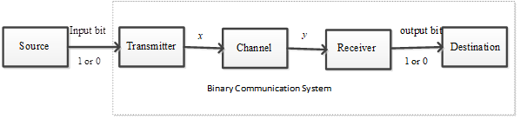
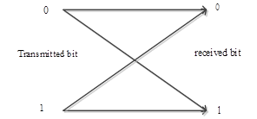
Practical Example – Digital Communication System

Slide 35
Digital Communication System Example Continued

Slide 36
Game show (Monty Hall Problem) http://www.bing.com/images/search?q=monty+hall+problem
There are 3 doors labeled Door1, Door2 and Door3. Behind one door is a car, behind each other door is a goat. The objective is to win the car. You select a door which remains closed, and the host opens one of the 2 remaining doors to show a goat. Would you remain with your first choice or switch to the other closed door?

Slide 37
Game show (Monty Hall Problem) http://www.bing.com/images/search?q=monty+hall+problem

Slide 38
Game show (Monty Hall Problem)
$$B_{1}=\left\{Car behind door 1\right\},$$
$$B_{2}=\left\{Goat behind doors 2\right\},$$
$$B_{3}=\left\{Goat behind doors 3\right\}.$$
Pick $B_{1} and host opens { B}_{2}$ or $B_{3}$
$$P\left[C | no switch, host opens { B}_{2} \text{or} B_{3}\right]=\frac{1}{3},$$
$$P\left[C | switch\right]=0$$

Slide 39
Game show (Monty Hall Problem)
Pick $B_{2} and host opens { B}_{3}$ or pick $B_{3} and host opens { B}_{2}$
$$P\left[C | host opens { B}_{2} \text{or} B_{3} and no switch\right]=0,$$
$$P\left[C | host opens { B}_{2} \text{or} B_{3} and switch\right]=$$
$$=P\left[host opens { B}_{2} and switch\right]$$
$+P\left[host opens B_{3} and switch\right]$
$$=\frac{1}{3}+\frac{1}{3}=\frac{2}{3}$$

